Slide 1
College Council
September 16, 2021

Slide 2
Reporting Committees

Slide 3
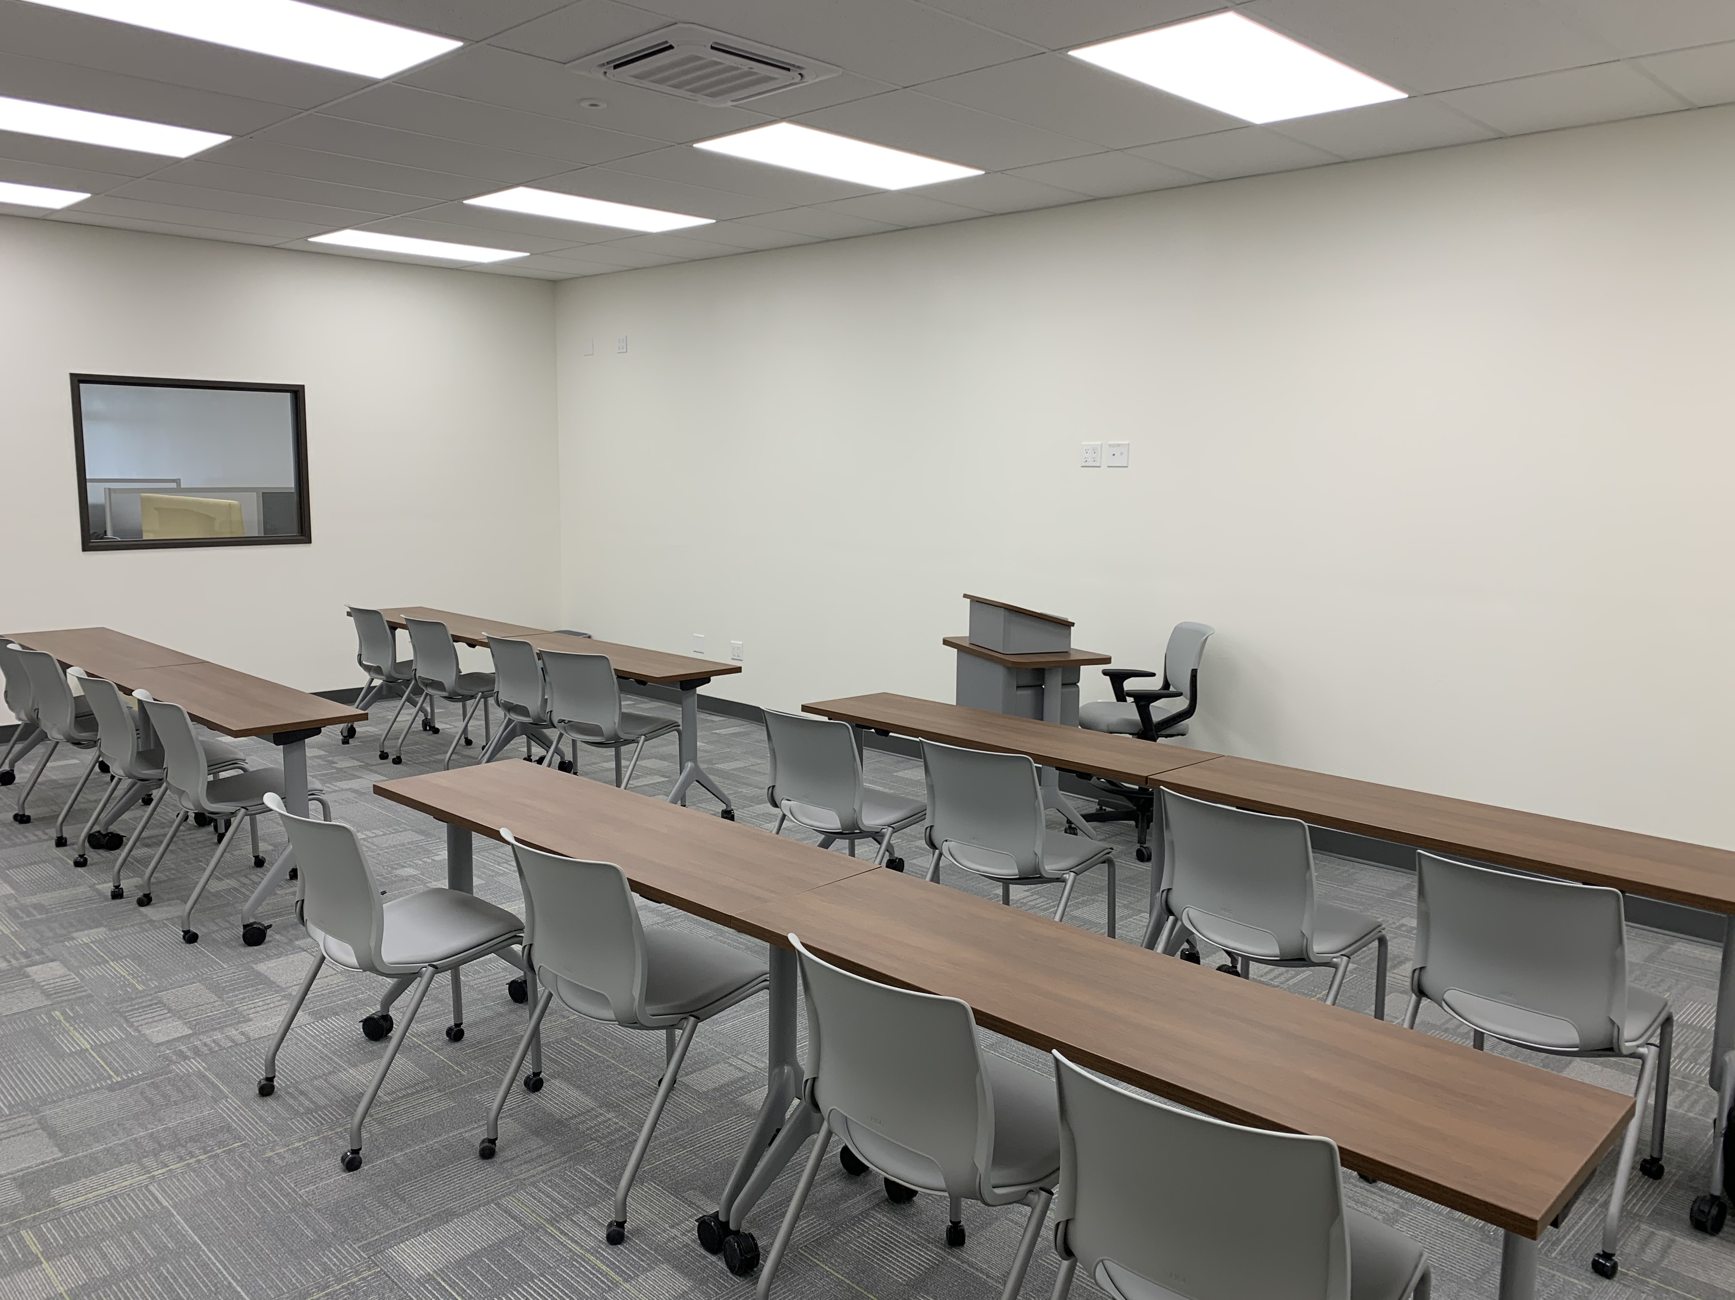
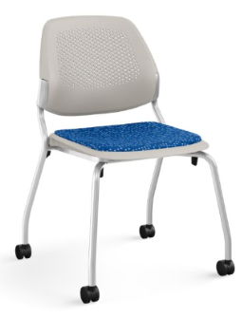
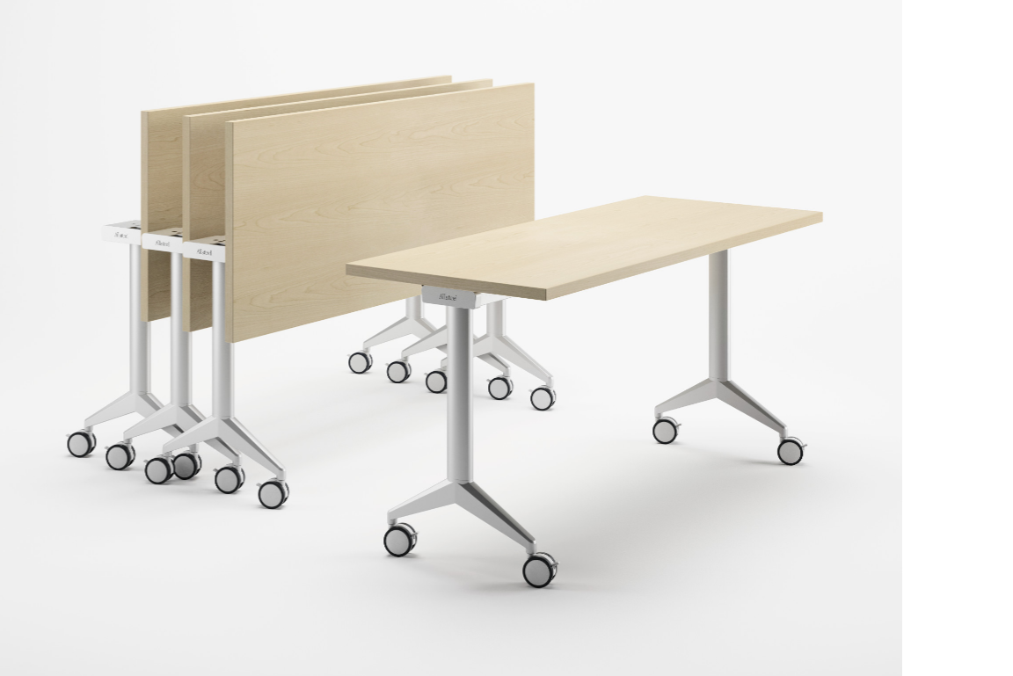
Facilities – Cody Pauxtis
Meeting held on 15 September
State Project List
East Wing Furniture

Slide 4
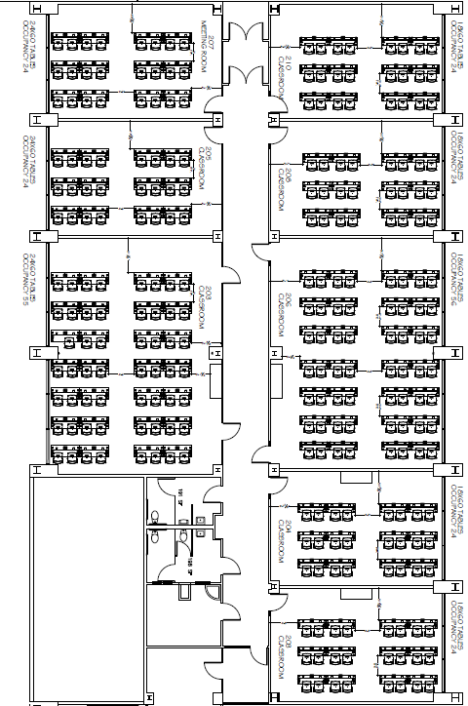
Facilities – Cody Pauxtis

Slide 5
Safety & Security – Kevin King
1st Meeting September 21,

Slide 6
Technology Resource Team (TRT) – Mike Campbell
TRT meet last week
Discussed Outdoor Wi-Fi
Zoom Carts
Student Loaner devices
East Wing Classrooms
Need 2 classified members

Slide 7
Student Success Support Programs (SSSP) – Heather Ostash
First meeting- 09/15/21
New co-chair and new members (Tyson Huffman- Co-chair, Yvonne Mills- Academic Senate President, Yifhen Chen- Math Representative, Debilyn Kinzler- English Representative, Andrew Burch- Flex Coordinator, Jessica Kawelmacher- Classified Representative)
Revisit of representative roles on communication, input and consultation
Discussion of Pillar 4- Ensuring Learning- Practices A-C- addressing recommendations via Faculty Flex Committee, Program Review Committee and a possible Faculty Inquiry Group
Communications and Career Guidance C-Fits Continue this semester

Slide 8
Incarcerated Students Education Program – Peter Fulks
First Meeting is 9/28

Slide 9
Discussion Items

Slide 10
Associated Committees

Slide 11
Budget Development – Lisa Couch
Met September 8, 2021
Finalizing budget process (including rubric) - should be available early this week
Budget software training will also be done in the next few weeks.
Continuing to review HEERF (COVID) funding requests regularly
Next meeting date is TBD

Slide 12
District Wide Budget Development Committee – Lisa Couch
Met September 3, 2021
Reviewed changes to 2021-22 DO Budget
Reviewed changes to 2021-22 Adopted Budget Allocation
Reviewed tentative schedule for district annual unit reviews (DAUR)
Reviewed goals for 2021-22 (new internal allocation model)
Next meeting date is pending

Slide 13
Institutional Effectiveness Committee (IEC) – Corey Marvin
Has not met yet, first meeting next Thursday, Sept. 23, 3-4:30

Slide 14
Professional Development Committee – Corey Marvin
Met yesterday but no classified staff members were present so no business was conducted other than information items. CSEA notified. Next meeting scheduled for Wednesday, Oct 20, 3-4:30.

Slide 15
Accreditation – Corey Marvin
No meeting currently set

Slide 16
The End

